Slide 1
Audio Steganography and watermark
Team: Group 4

Slide 2
CONTENTS
1
Team Members
2
Introduction
3
Implementation
4
Achievement
5
Application
6
Summary

Slide 3
PART ONE
Team Members

Slide 4
OUR TEAM
Jingmiao Zhang
Xinyue Wei
Panyue Wei
Junchao Wang
University of Science and Technology of China
Information Security
LSB
Noise
Xi'an Jiaotong University Science and Technology
DWT+Image
Compression
Huazhong University
Science and Technology
DCT+Audio
Resampling
Sichuan University
Software Engineering
DCT+Image
Filtering

Slide 5
PART TWO
Introduction

Slide 6
Piracy
37
57
29
90
%
%
%
%
Worldwide average piracy rate of 37% in 2017
The average piracy rate in Asia Pacific was 37% in 2017
In 2020, the overall infringement rate in the UK in the field of music and sport is 37%.
There were six countries with software piracy rates above 90% worldwide in 2009.
Worldwide
Asia
UK
Six
countries

Slide 7
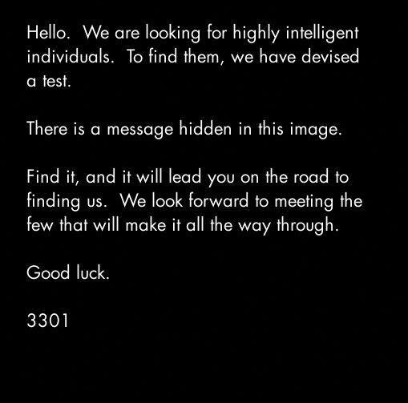
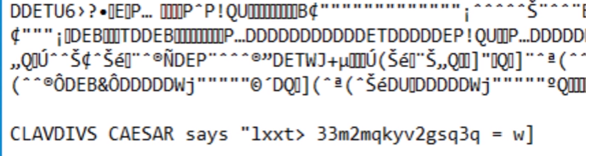
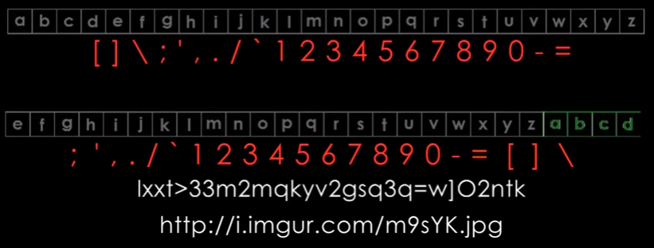
Steganography

Slide 8

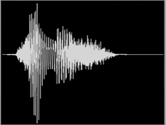


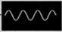

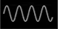
Time Domain
Frequency Domain
Transform audio from time domain to frequency domain
……

Slide 9
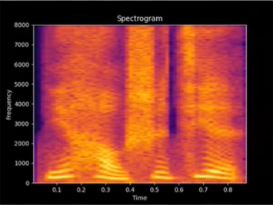
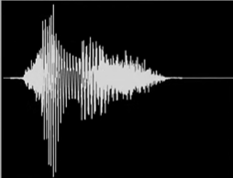
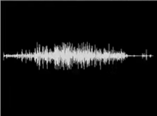
Time Domain
Insert original audio
Frequency Domain
watermark
Treat the watermark as a spectrogram and generate audio in reverse

Slide 10
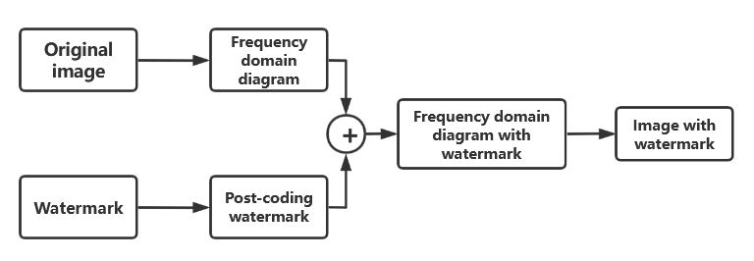
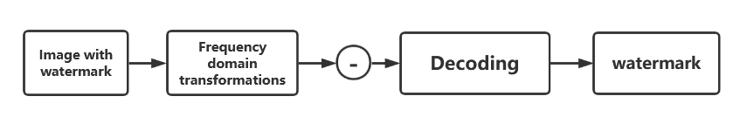
Steganography
图2-1：Embed watermark
图2-2：Extract watermark

Slide 11
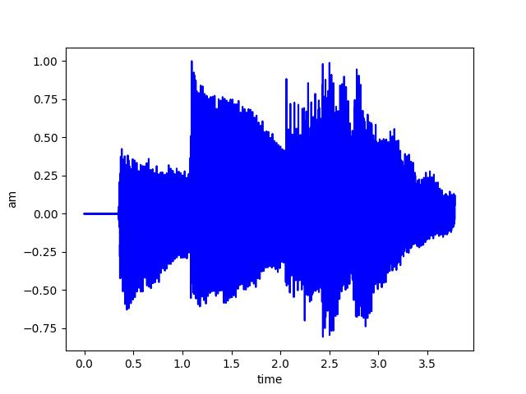
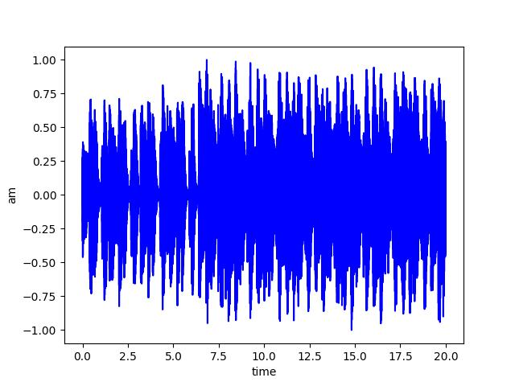
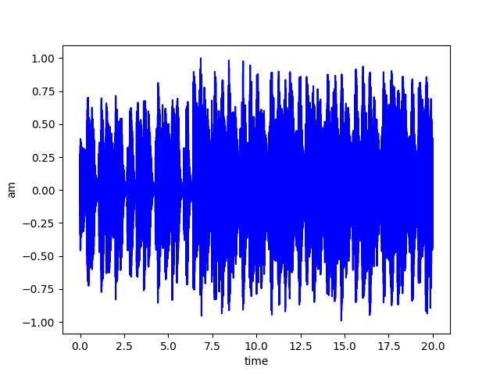
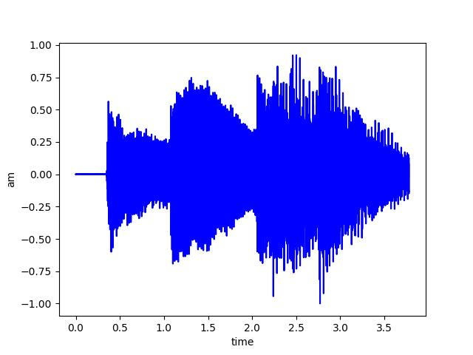
Watermark Audio
Without Attack
Original Audio
Embedded Audio
Embedding
Extraction
Extracted Audio

Slide 12
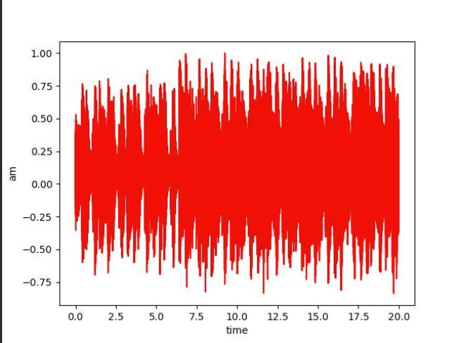
Watermark
With Attack
Original Audio
Embedded Audio
Embedding
ATTACK!
Extracted Watermark
Extraction
WRONG!

Slide 13
ROUTE
Step 04
We have applied this to digital watermarking with the knowledge of public and private keys..
s
Step 03
Of course, testing the performance of the watermark is also an essential part of the process.At the same time, we propose the innovative DWT-LSB method.
V
Step 02
Each of us has implemented a mainstream method such as LSB to add watermarks to audio.
d
X
Step 01
Learn about digital watermarking and read papers. Determined to add watermark to audio. Because it's rarely done, it's cool to try.

Slide 14
PART THREE
Implementation

Slide 15
Method
LSB
DCT_Image
LSB is a watermarking technique in the spatial domain. It is a way of adding a watermark by changing the least significant bit.
DCT is a method of adding information in the transform domain of an image. It is more robust and less likely to be detected. The image is used here as a watermark.
DCT_Audio
DWT
Not all watermarks have to be images, in fact they are just arrays of them! We would also like to try audio as a watermark.
DWT is also a method applied to transform domain. Different from DCT, DWT uses wavelet transform, while DCT uses discrete cosine transform.

Slide 16
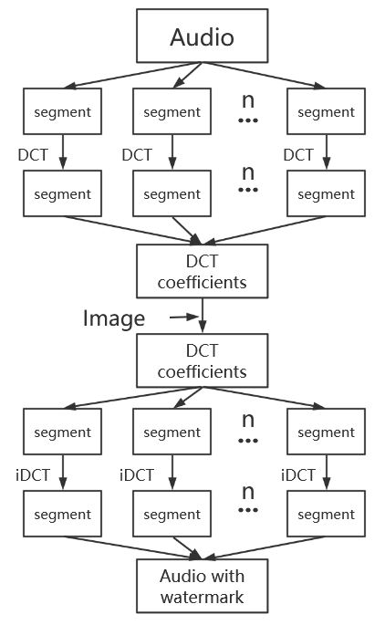
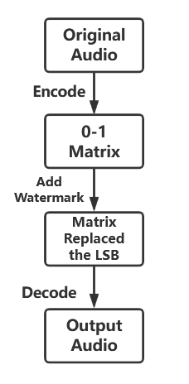
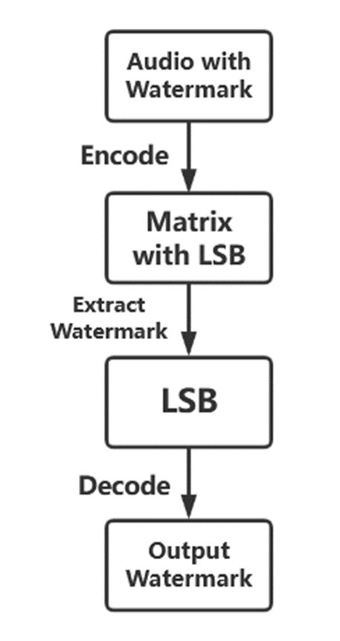
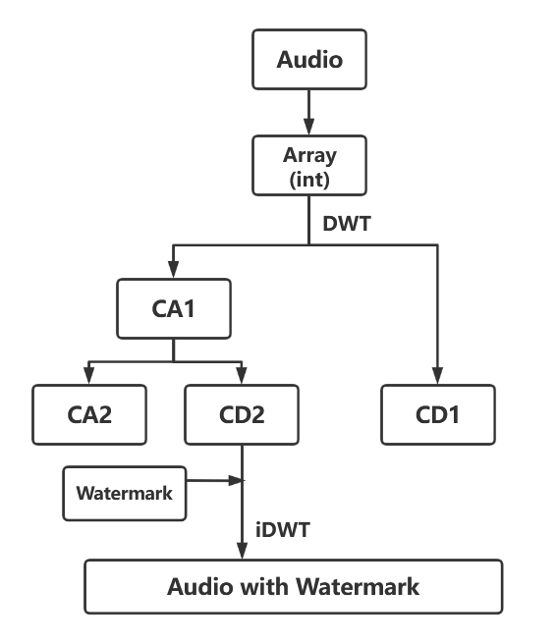
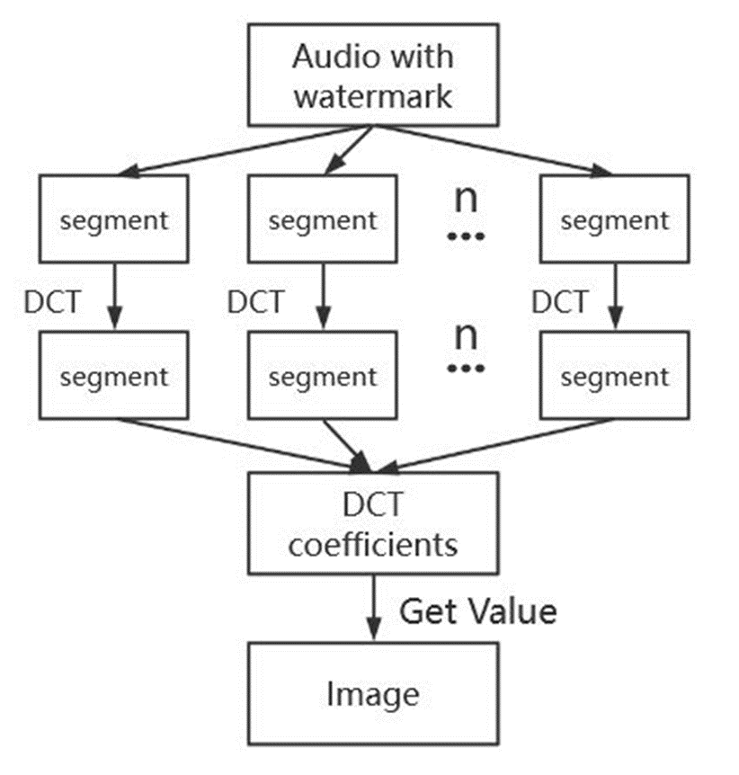
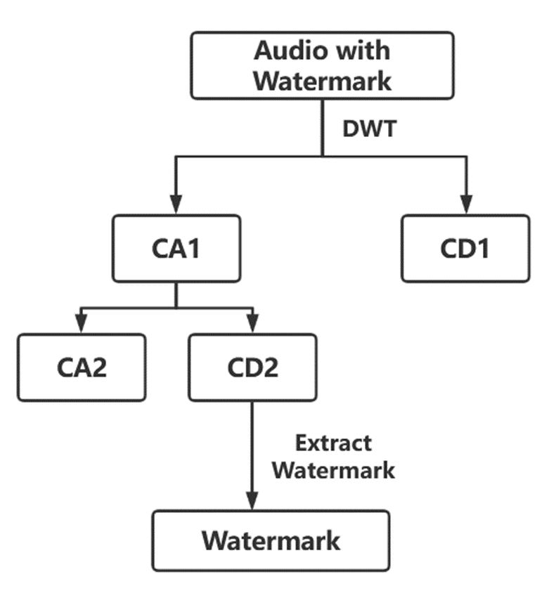
Embedding- Extraction

Slide 17

DWT-LSB：a better choice
Insert Array
DWT insertion
DWT-LSB insertion
Audio Array- cD2
46, -12,-15, 653, 25, 85, 174, 30
Audio Array: [102,89,46,…]
Applying DWT to it, the cD2 array: [46, -12, -15, 653, 25, 85, 174, 30, …]
Audio Array- cD2
46, -12,-15, 653, 25, 85, 174, 30
Audio Array- cD2
46, -12,-15, 653, 25, 85, 174, 30
Watermark Image Array
59, 58, 58, 52, …
Bit array(image)
1, 1, 0, 1, …
Audio Array- cD2 after insertion
59, -12,58, 653, 58, 85, 52, 30
Audio Array- cD2 after insertion
bn, -12,bn, 653, sn, 85, bn, 30
Watermark Image Array:[59, 58, 58, 52,…] every element in [0,255]
Changing it to bits: [1,1,0,1,1,1,0,0,…]
bn: a big number,
for example let bn = 100
sn: a small number , e.g. sn = 10

Slide 18
PART FOUR
Achievement

Slide 19

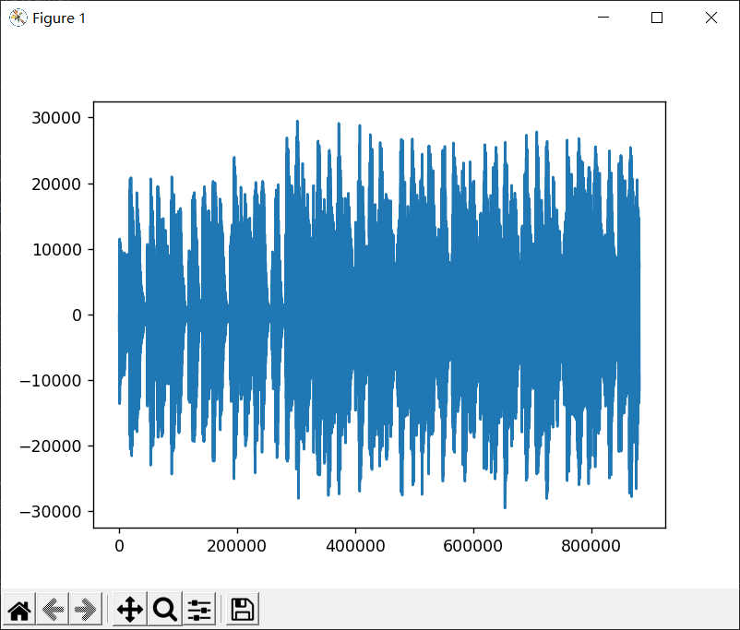
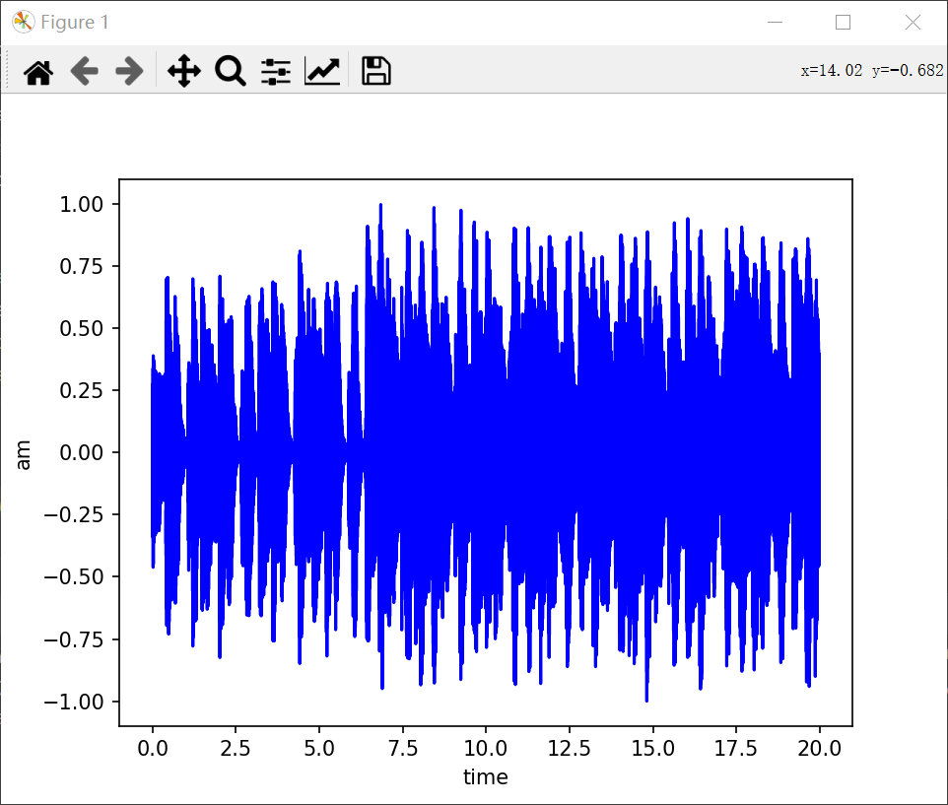
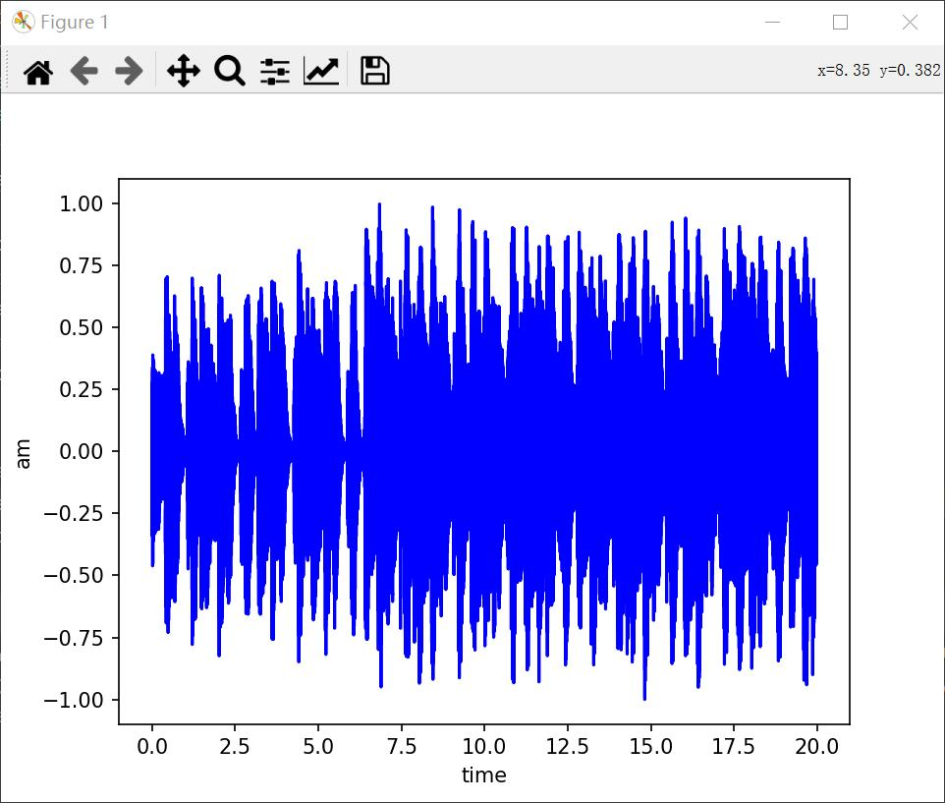
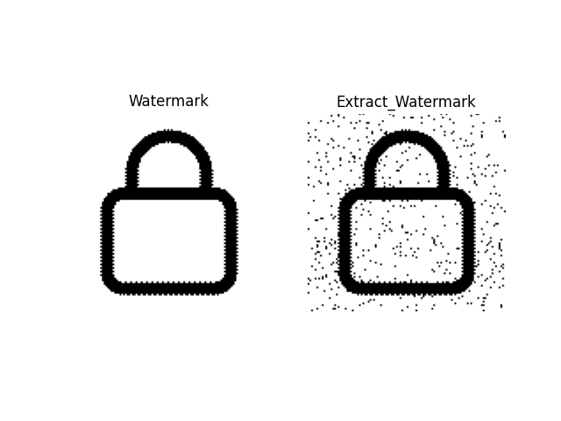
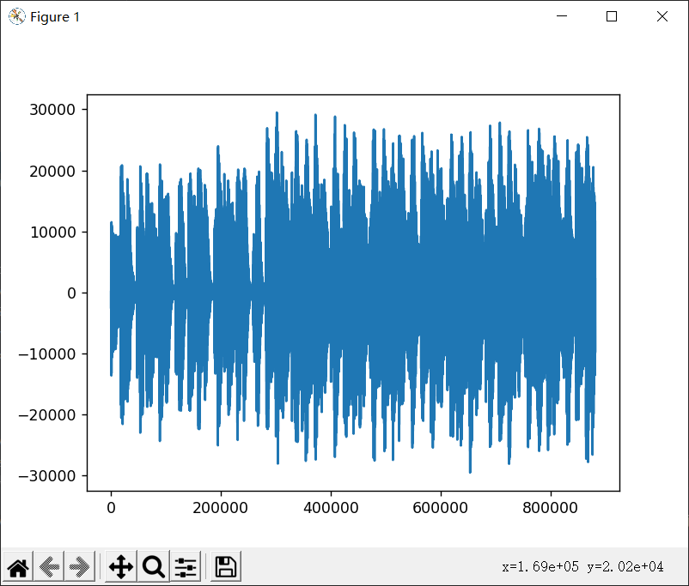
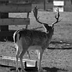
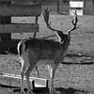
Like this

Slide 20
Attacks
Merging
Cropping
Combine multiple audios together.
Removing some specific part of the audio.
Noise
Filtering
unnecessary or superfluous information
Removing some data, usually remove noise, but here it is an attack.

Slide 21

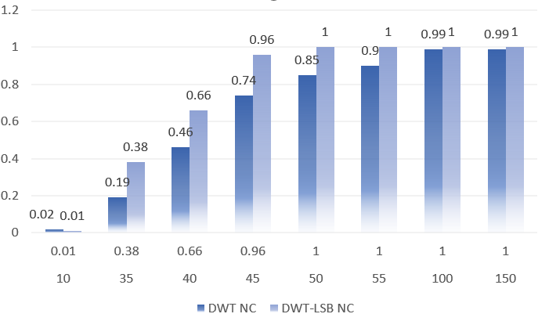

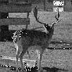


Robustness
SNR=10
SNR=50
Original
SNR=100
SNR=150
DCT Original Watermark
Watermark After Merging

Slide 22
Analysis
DWT-LSB
Best
By combining the LSB approach, we are typically able to reduce the error to within 10 in each variation of the data, further improving the accuracy of the extraction.
DWT
Very good
It is possible to divide the signal into different important segments. It is possible to defend against attacks relatively well.
DCT
Good
Multiple DCT transforms can cause loss of floating point numbers resulting in compromised robustness.
LSB
Fine
Changing only the last digit of each value adds less intensity to the watermark.

Slide 23
PART FIVE
Application

Slide 24









A Double Ended Scenario
RSA
Encryption
Extract
Decryption
ADD
SHA256
Designature
SHA256
Digest
Digest
Copyright
Watermark
Audio
Copyright
Digest
Signed Digest

Slide 25
PART SIX
Summary

Slide 26
Summary
01
02
03
04
Implementation
Improvement
Robustness
Application
We implementthree algorithms LSB, DCT and DWT to watermark respectively. All of them are unobtrusive and can be successfully extracted and identified.
We propose a new DWT-LSB algorithm based on the DWT algorithm, which is more optimized.
We test the robustness of all the algorithms we have used. This includes noise adding, cropping, merging, volume changing, etc.
We introduce a two-terminal communication scenario, which applies public key cryptography, symmetric cryptography and watermarking algorithms to ensure the security of copyright information.

Slide 27
THANKS!

